Slide 1
GTA Workshop Diversity, Equity and Inclusion
Missouri University of Science and Technology
William Smith, Director of Strategic Diversity Initiatives

Slide 2
Love Has No Labels

Slide 3
Questions & Comments
How did the video make you feel?
Comments
Notes:
Did it make you feel like everyone was welcome?
Were the people happy? Why?

Slide 4
ADA Accommodations
Employe ADA Accommodations
Sammatha Yelton
ETIX
900 Innovation Drive,
Suite 500
(573) 341-7734
Student ADA Accommodations
Carol Durk
Accessibility and Testing
Norwood Hall,
G10
(573) 341-4333

Slide 5
Equity and Title IX

Slide 6
The University of Missouri Nondiscrimination Statement
The University of Missouri does not discriminate on the basis of race, color, national origin, ancestry, religion, sex, pregnancy, sexual orientation, gender identity, gender expression, age, disability, protected veteran status, and any other status protected by applicable state or federal law. The University’s Nondiscrimination policies apply to any phase of its employment process, any phase of its admission or financial aid programs, other aspects of its educational programs or activities, and instances occurring in other settings, including off-campus, if there are effects of the conduct that interfere with or limit any person’s ability to participate in or benefit from the University’s educational programs, activities or employment.
Equal Employment/Educational Opportunity Policy 320.01
University of Missouri Collected Rules & Regulations (CRRs)
Notes:
This is the university’s EE/EO policy on discrimination. It can be found within the Collected Rules and Regulations.
Please take the time to read.

Slide 7
University of Missouri System Nondiscrimination Policy
Not to discriminate on the basis of:
Race
Color
National Origin
Ancestry
Religion
Age
Disability
Protected Veteran Status
Sex
Pregnancy
Sexual Orientation
Gender Identity
Gender Expression
Other applicable status defined by law
Missouri University of Science and Technology
Notes:
The office of Equity and Title IX receives and addresses complaints and issues of discrimination and harassment on campus and in places where university business is conducted.
Basically, it states that we, at S&T, value people’s authentic selves within the context of what our laws state as equity and fairness. I recommend that you visit the mission statement and values to get an institutional viewpoint.

Slide 8
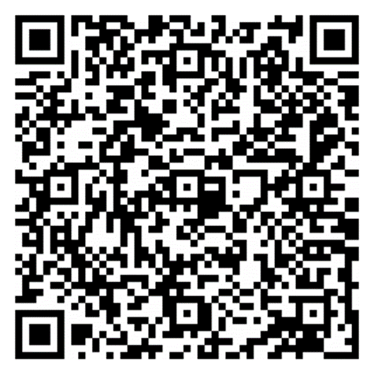
Ways to Contact ETIX
Report Online
573.341.7734
900 Innovation Drive Suite 500
Notes:
For clarification, or if you or anyone you know has experienced discrimination on campus or while participating in a campus event, you may seek assistance or make a report through these avenues: online, by phone, or in-person. Alternatively, you may report to University Police.

Slide 9
Reporting Responsibilities
Any employee of the university who becomes aware of discrimination including sex discrimination as defined in this policy is a mandated reporter, regardless of whether the recipient of the behavior is a student, employee, volunteer, or visitor of the university.
Rights and Responsibilities – Equity and Title IX | Missouri S&T (mst.edu)
Missouri University of Science and Technology

Slide 10
Strategic Diversity Initiatives

Slide 11
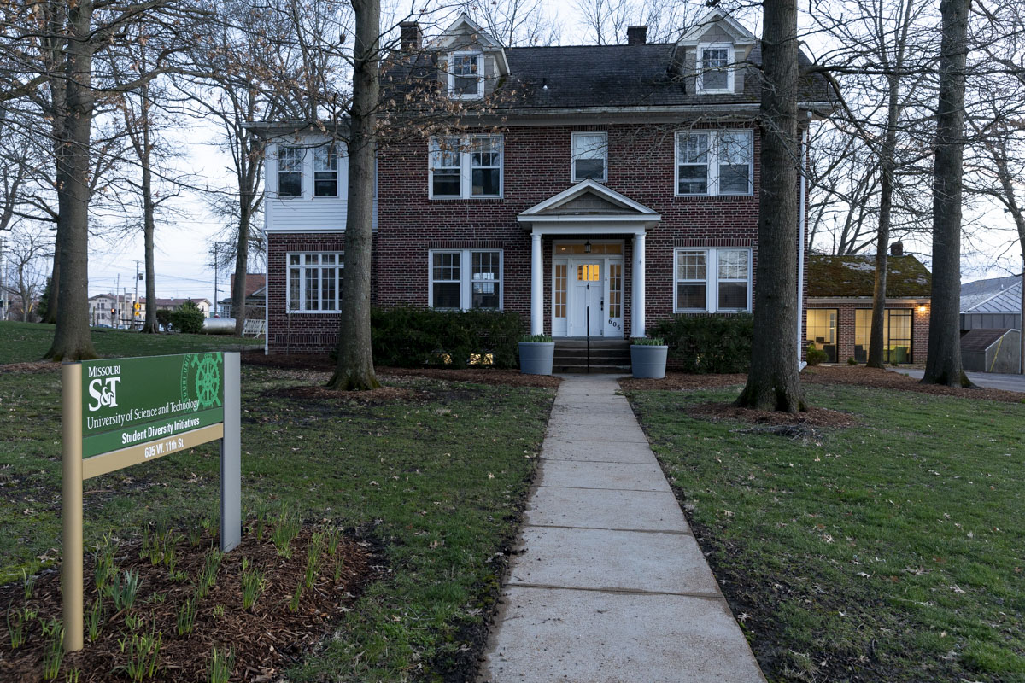
The Diversity House
605 W 11th

Slide 12
Strategic Diversity Initiatives
Food Pantry
Clothing Closet
Student Meeting Place
Missouri University of Science and Technology

Slide 13
Programs
Trainings
Workshops
Field Trips
Game Nights

Slide 14
Your Part???

Slide 15
You Should . . .
Continue
Continue to Learn
Seek Out
Seek Out New Experiences
Do
Do Your Part

Slide 16
Diversity
Human differences including but not limited to race, ethnicity, gender, gender identity, sexual orientation, age, social class, physical ability or attributes, religious or ethical values system, national origin, and political beliefs.

Slide 18
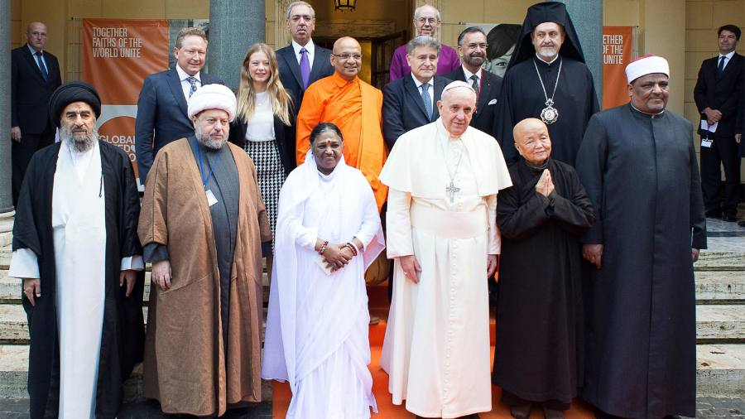
Cultural Competence
The ability to understand, communicate with, and effectively interact with people across cultures

Slide 19
Cultural Competence Includes
Being aware of one’s own worldview
Developing positive attitudes towards cultural differences
A willingness to accept and respect cultural differences
Gaining knowledge of different cultural practices and worldviews
Incorporating these competencies into institutional practices, polices, procedures, and programming

Slide 20
Our World Our Campus
What stands out in the picture?
What do you notice?
Where are you on picture?
Do you see yourself in multiple areas?
Is there anything missing?
Notes:
Items Missing:
Marital Status
Birth Order
Parenting status (children or no children)
Body Size

Slide 21
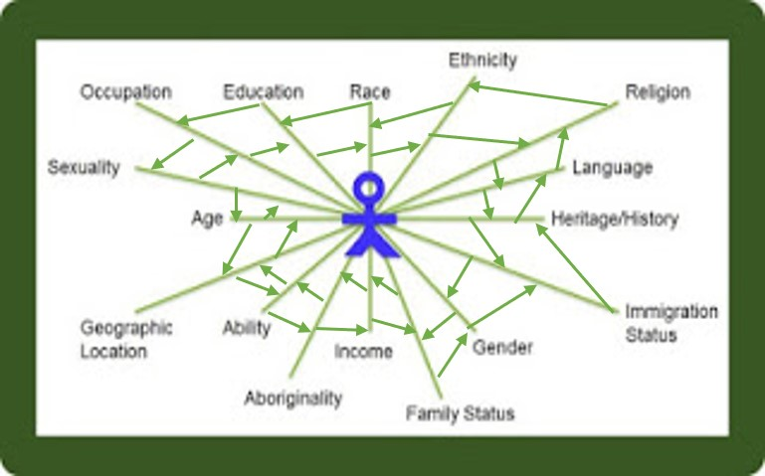
Intersectionality
Social categorizations such as race, age, gender, etc. as of a given individual or group

Slide 22
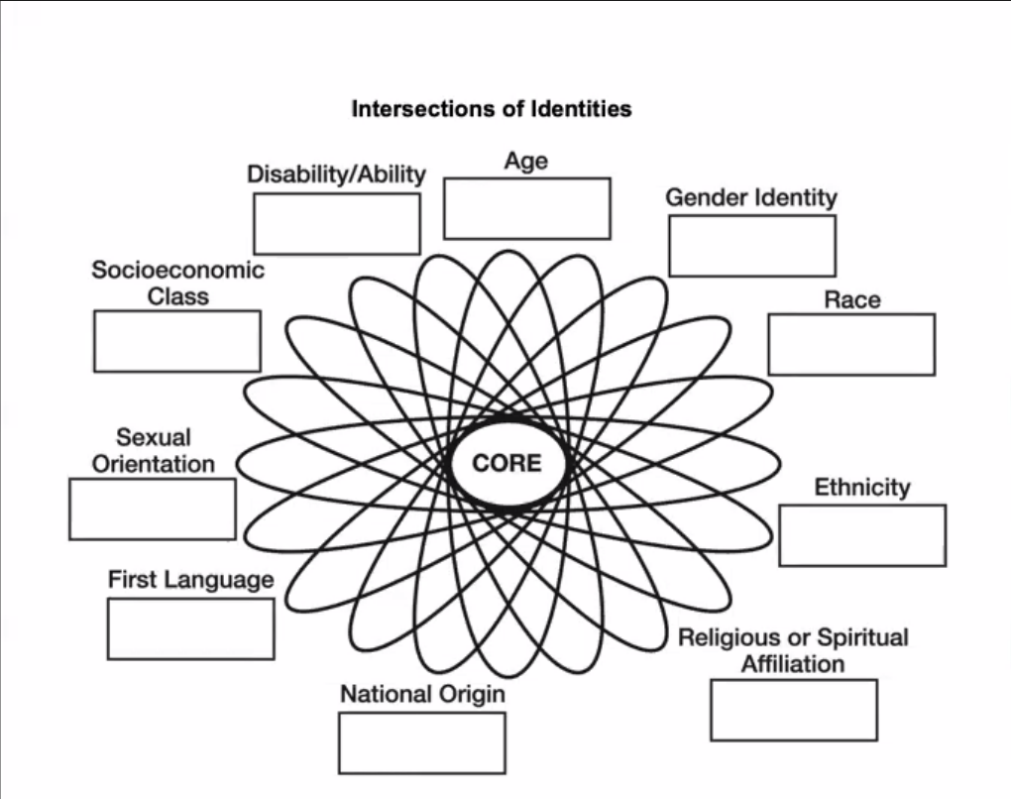
You!!!
Which do you identify most with?
Which do you identify least with?
Which identities most affect how you perceive yourself?
Which identities most affect how others perceive you?
Which identity intersections are the most significant to you?
You may add any others.
Notes:
Handout

Slide 24
Diversity, Equity and Inclusion Division
Dr. Nicole A. Roberson, Vice Chancellor and CDO
Vice Chancellor’s Office
900 Innovation Drive,
Suite 500
(573) 341-4023
dei.mst.edu
Missouri University of Science and Technology
Notes:
Remind participants about reporting concerns of discrimination to any of these offices, University Police, and any employee on campus.
24

Slide 25
Diversity, Equity and Inclusion Division
Equity and Title IX Department
900 Innovation Drive,
Suite 500
(573) 341-7734
equity.mst.edu
Strategic Diversity Initiatives Department
The Diversity House
605 W 11th
(573) 341-4212
sdi.mst.edu
Missouri University of Science and Technology
Notes:
Remind participants about reporting concerns of discrimination to any of these offices, University Police, and any employee on campus.
25

Slide 26
Resources
Love Has No Labels: https://www.youtube.com/watch?v=d_izgo1qVEo

